Slide 1
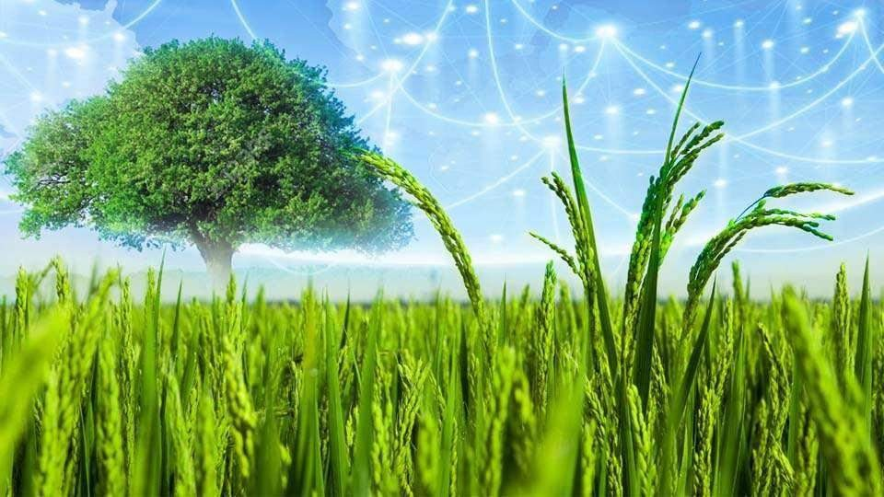










UNIT- X
Economic
botany

Slide 2





Definition
Economic
botany
» Economic botany is the study ofthe relationship between people and plants for food, medicines and otheruses.
» Economic botany intersects many fields such as agronomy,
anthropology, archaeology, chemistry, trade and commerce.

Slide 3

Economic
botany
Relationship between humans and plants
Relationship between humans and plants co-existed several hundreds of years ago selecting many wild plants by trial and error, which have led to the development of the humans and their civilization in many ways.

Slide 4
Domestication of plants
Economic
botany
» Domestication is the process of bringing wild plant into cultivation through careful selection and genetic alteration to provide food and other benefits to human.

Slide 5
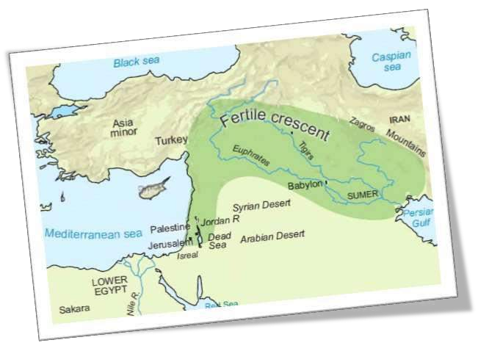
Economic
botany
Origin ofAgriculture
According to the archeological evidence agriculture initiated from the fertile crescent region in and around Tigris and Euphrates river val eys, approximately about 12,000 yearsago.
Greek and Roman naturalists like Theophrastus, Dioscorides, Pliny the elder and Galen laid down the scientific foundation in understanding origin and domestication of cultivated plants.

Slide 6
Economic
Alexander Von Humboldt - Origin of most useful plants is animpenetrable secret.
Darwin’s evolutionary theory - origin of useful cultivated plants through natural selection and hybridisation.
1807
botany
1868
1883
1887
1943
De Candol e - Attempted to solvethe mystery about the ancestral form, region of domestication andhistory.
Nikolai Ivanovich Vavilov - Vavilov has given the centre of diversity of a crop species which may be the centre of origin for that species.
HISTORY OF AGRICULTURE
Zhukovsky - put forward theconcept of mega gene centre for the origin of cultivated plants.
Harlan - Acrop may not have a single centre of origin. Thecentre of cropplantmeansthe placesof agricultural origin and the non-centre is the place where the crop wasintroducedand spread.
1968
1971

Slide 7

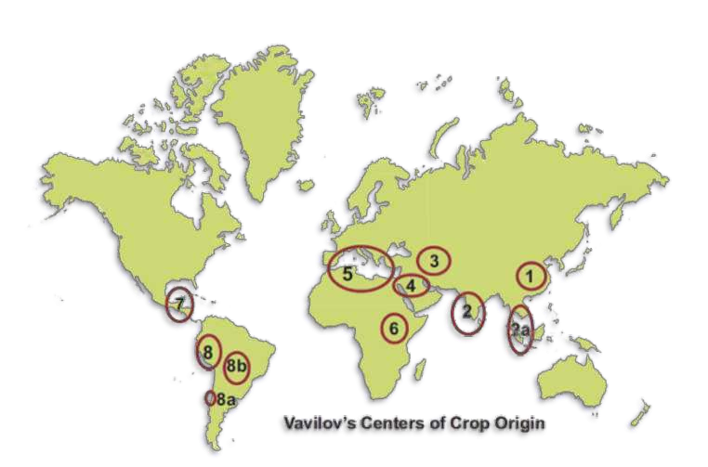
Economic
Vavilov’s Centre of
Crop Origin
China
India
a South EastAsia
Central East
The Near East
Mediterranean
Crops domesticated
botany
Foxtail millet, soybean, bamboo, onion, crucifers.
Rice, sugarcane, mango, orange, eggplant, sesame.
Rice, banana, coconut,
clove , hemp.
Wheat, pea, hemp, cotton etc. Wheat, rye, many subtropical
and tropical fruits.
Olive, vegetables, oil yielding plants, wheats
6 Ethiopia (Abyssinian)
Wheat, barley, sesame, castor, coffee.
7 Mesoamerica
Maize, bean, sweet
potato, papaya, guava, tobacco.
(South Mexican & Central American Centre)
8 South America 8 a
Tomato, pine-apple
The Chiloe Centre
Potato
8 b The Brazilian -
Paraguayan Centre Groundnut, cashew nut, pine apple, peppers, rubber.

Slide 8
Organic Agriculture
Economic
botany
» Organic farming in an alternative agricultural system to rapidly changing farming practices.
» Itsustains the health of the soils, ecosystems and people.

Slide 9

Biofertilizers
Economic
botany
» Biofertilizers are defined as preparations containing living cel s or latent cel s of efficient strains of microorganisms that help crop plants in fixing nitrogen, solubilisingphosphate and decomposing cel ulose.
» They are eco-friendly organic agro inputs and are more efficient
and cost effective than chemical fertilizers.

Slide 10
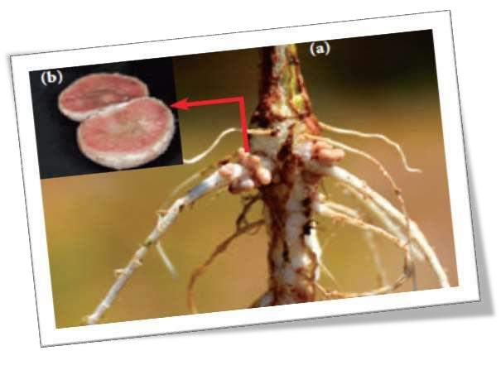
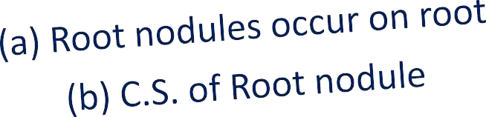
Rhizobium (Symbiotic bacteria)
Economic
botany
» Best suited for paddy field which
increase the yield by 15 –40%

Slide 11

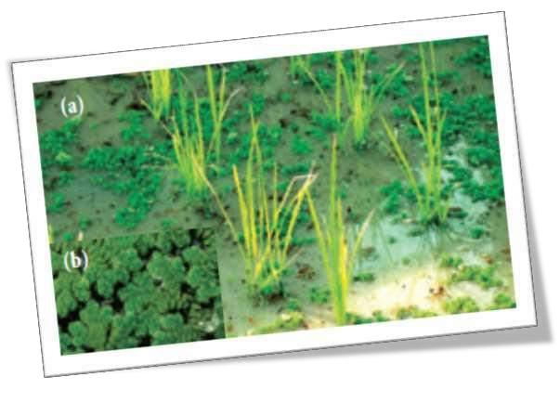





Azolla (Free floating water fern)
Economic
botany
» Suited for wetland ricecultivation and increase the yield
40 - 60kg/ha/crop as it quickly decomposes in soil.

Slide 12

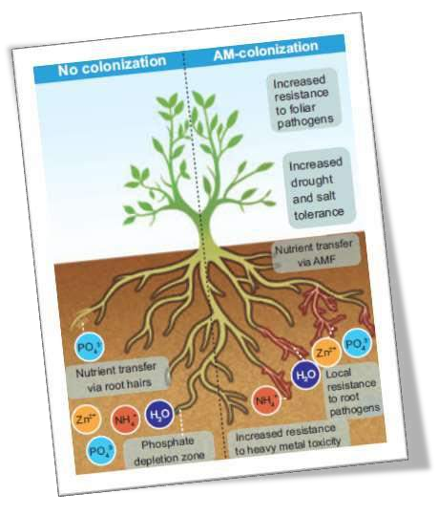

Arbuscular mycorrhizae
Economic
botany
(Phycomycetous fungi and angiosperm roots)
» Has ability to dissolve the phosphates found in abundance in soil.
» AM provides necessary strength to
resist disease, germs and unfavourable weather conditions.
» It also assures water availability.

Slide 13

Seaweed Liquid Fertilizer Kelp (Brown algae)
Economic
botany
» Seaweed liquid fertilizer (SLF)contains cytokinin, gibberellins and auxin apart from macro and micronutrients.
» The alginates in the seaweed that reacts with metals in the soil and form long,
cross-linked polymers in the soil.
» These polymers improve the crumbing in the soil, swell up when they get wet
and retain moisture for a longtime.
» Seaweed has more than 70 minerals, vitamins and enzymes.
» Improves resistance of plants to frostand disease.
» Seeds soaked in seaweed extract germinate much rapidly and develop abetter
root system.

Slide 14

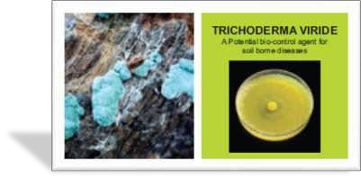
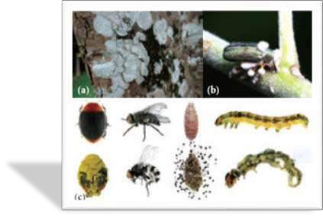
Bio-Pesticides
Economic
botany
» Bio-pesticides are biologically based agents used for the control ofplant pests.
» They are in high use due to their
non-toxic, cheaper and eco-friendly characteristics as compared to chemical or synthetic pesticides.
» Bio-pesticides have become an integral
component of pest management in terms of the environmental and healthissues attributed to the use of chemicals in agriculture.
Trichoderma fungi
Biopesticide
Beauveria Fungi
Beauveria sps infected insect on green plant
Entomopathogenic on insets

Slide 15
Green Manuring
Economic
botany
» Green manuring is defined as the growing ofgreen manure crops directly in the field by ploughing.
» One of the main objectives of the green manuring is to increase the content of
nitrogen and improve the structure and physical properties of the soil.
» The most important green manure crops are Crotalaria juncea,Tephrosia purpurea, Indigofera tinctoria.
» The green manuring can be practised as Green in-situ manuring or Greenleaf
manuring.

Slide 16

Plant Breeding
Economic
botany
» Plant breeding is the science of improvement of crop varieties with higher yield, better quality, resistance to diseases and shorter durations which are suitable to particular environment.
» In early days, plant breeding activities were based mainly on skil s and ability of
person involved.
» But as the principles of genetics and cytogenetics have elucidatedbreeding
methods such as selection, introduction, hybridization, ploidy, mutation, tissue culture and biotechnology techniques were designed todevelop improved crop varieties.

Slide 17

Objectives of PlantBreeding
Economic
botany
» Toincrease yield, vigour and fertility of thecrop
» Toincrease tolerance to environmental condition, salinity, temperature and drought.
» Toprevent the premature falling of buds, fruits etc.
» Toimprove synchronousmaturity.
» Todevelop resistance to pathogens and pests.
» Todevelop photosensitive and thermos-sensitivevarieties.

Slide 18

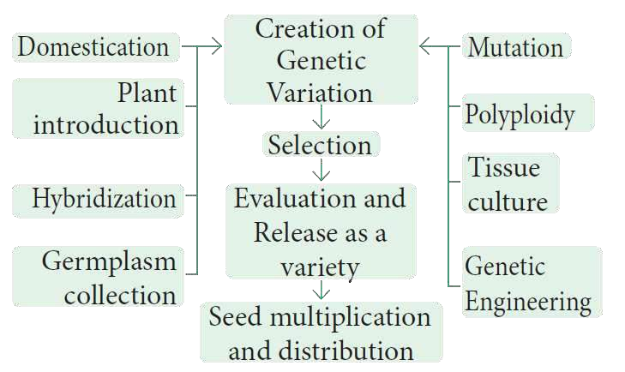

Economic
botany
Steps in PlantBreeding

Slide 19



















Economic
Primary Introduction
Plant Introduction
botany
Secondary Introduction
Conventional Plant Breeding Methods
Natural
Mass
Selection
Artificial
Pureline
Intravarietal
Clonal
Intervarietal
Hydridisation
Interspecific
Intergeneric
M utational
Euheterosis
Heterosis
Mutation
Breeding
Polyploidy Breeding
Green Revolution
Balanced
Psuedoheterosis

Slide 20



Economic
botany
Plant Breeding for Developing Resistance to diseases
Crop
Variety
Resistance to diseases
Wheat
Himgiri
Leaf and Stripe rust, hill bunt
Brassica
Pusa swarnim
(Kara rai)
White rust
Cauliflower
Pusa Shubhra,
Pusa snowball K-1
Black rot and curl blight black rot
Cowpea
Pusa Komal
Bacterial blight
Chilli
Pusa Sadabahar
Chilly mosaic virus, Tobacco mosaic virus and Leaf curl.

Slide 21
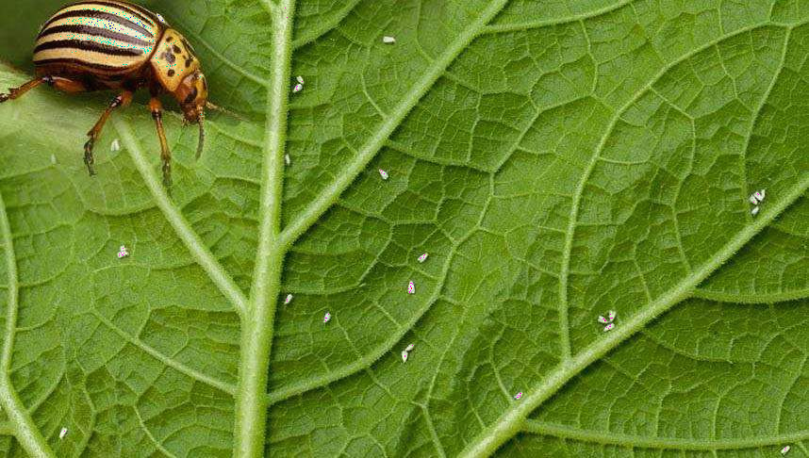
Economic
botany
Plant Breeding for Developing Resistance to insect pest
Crop
Variety
Insect pests
Brassica
(rapeseed mustard)
Pusa Gaurav
Aphids
Flat been
Pusa Sem 2
Pusa Sem 3
Jassids, aphids and fruit borer
Okra (Bhindi)
Pusa Sawani
Pusa A-4
Shoot and Fruit borer

Slide 22

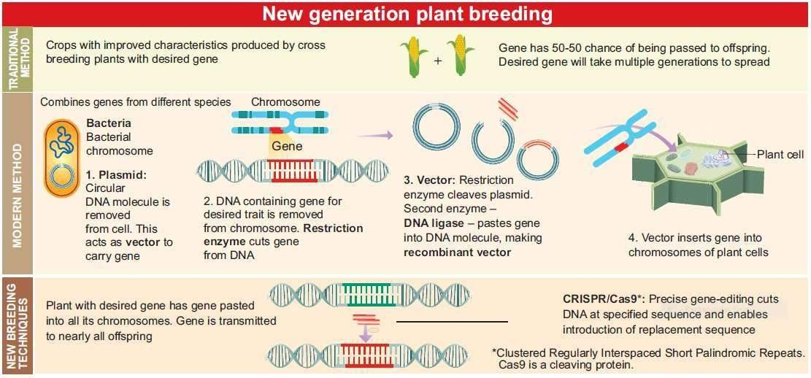

Economic
botany

Slide 23


Economic
botany
» Indian Plant Breeders
» National Bureau of plant Genetic
Resources (NBPGR)
» Gamma Garden or Atomic Garden
» NORIN 10
» Father of green revolution Norman E.Borlaug
» Father of green revolution in INDIA Dr.M.S.Swaminathan.
» Nel Jayaraman

Slide 24

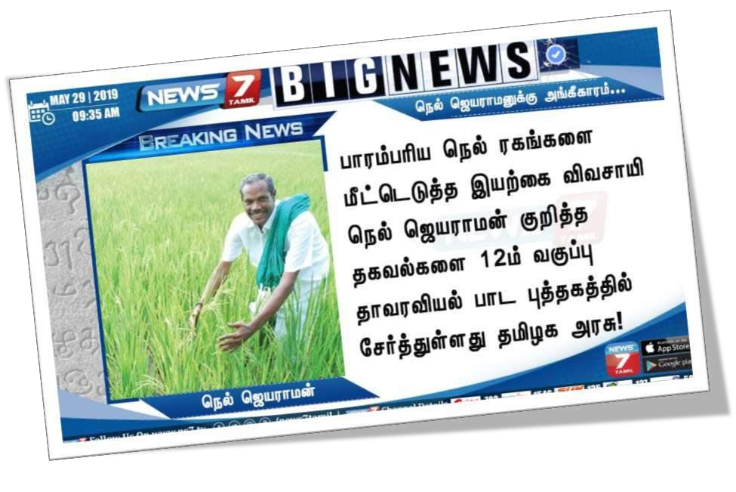
Economic
botany

Slide 25


Economic
botany

